Slide 1

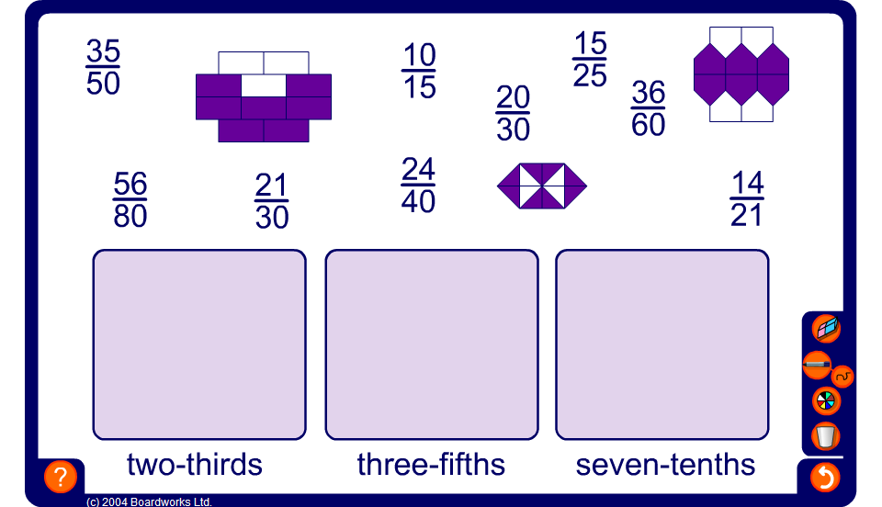


Drag and drop equivalent fractions
Notes:
Ask pupils in turn to choose a fraction and justify where it goes by dividing the numerator and the denominator by the same number. For fraction diagrams pupils must state the fraction shaded first.
Continue until all the fractions are in the correct place.
Ask pupils to come up in turns and choose a fraction to drag and drop into the correct place.

